Slide 1
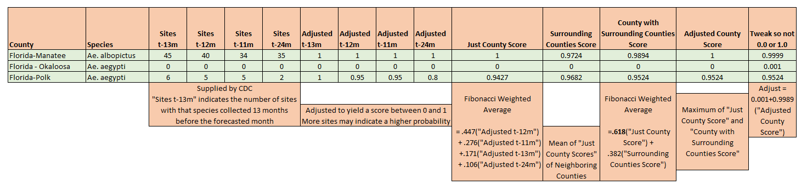
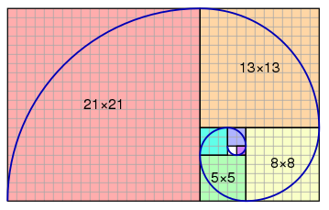
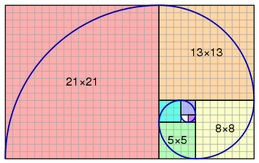
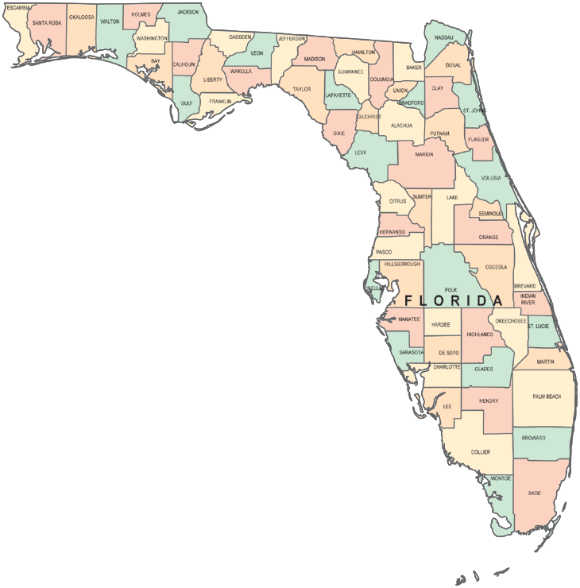
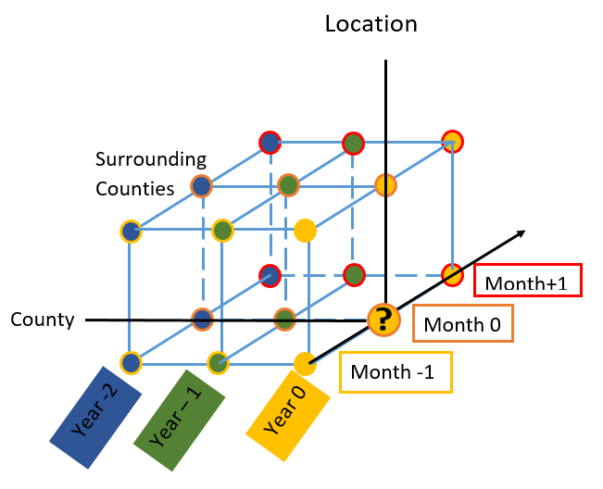
SWARM
Statistical Way to forecast Aedes Range with a Mesh
Jeff Morgan^{1,2}
http://swarmaedesmodel.com/
¹PhD student in Biomedical Engineering at Catholic University of America
²Systems Engineer with Systems Valens Solutions, Inc.
FIBONACCI WEIGHTING
F₀ = 0
F₁ = 1
F₂ = 1
F₃ = 2
F₄ = 3
F₅ = 5
F₆ = 8
F₇ = 13
F_{n} = F_{n-2} + F_{n-1}
For large n
F_{n}/F_{n-1} ≈ 1.618 ≈ Golden Ratio → F_{n-1}/F_{n} ≈ 0.618
(0.618)² = .382
F_{n-1}/(F_{n-1} +F_{n}) ≈ 0.382 → weight for “Surrounding Counties Score”
F_{n}/(F_{n-1} +F_{n}) ≈ 0.618 → weight for “Just County Score”
0.618
F_{n-3}/(F_{n-3} + F_{n-2} + F_{n-1} +F_{n}) ≈ .106 → weight for 24 months ago
F_{n-2}/(F_{n-3} + F_{n-2} + F_{n-1} +F_{n}) ≈ .171 → weight for 13 months ago
F_{n-1}/(F_{n-3} + F_{n-2} + F_{n-1} +F_{n}) ≈ .276 → weight for 11 months ago
F_{n} /(F_{n-3} + F_{n-2} + F_{n-1} +F_{n}) ≈ .447 → weight for 12 months ago
Model Description
The model is initially based on historical case data.
For each county and month x, a weighting strategy is based on last year’s month x, last year’s month x+1, last year’s month x-1, and 2 years ago month x.
This value is combined in a separate weighting strategy with the values for neighboring counties. Weighting factors are based on Fibonacci numbers. Surveillance data from the current year will be incorporated as it becomes available. Environmental factors may be added later, although the predictable factors (e.g., temperature during the coldest months) are already “baked into the historical data”
Fibonacci Diagram: https://dailywildlifephoto.nathab.com/photography-guide/a-golden-photo-rule-the-golden-ratio/
Credit: https://dailywildlifephoto.nathab.com/photography-guide/a-golden-photo-rule-the-golden-ratio/
The only surveillance data incorporated was a 29 Aug 2019 article in the Sacramento Bee that an Aedes Aegypti mosquito was detected in Sacramento
No environmental events were considered unusual enough to incorporate in the model
Textbook forming Basis of Approach
Kresyszig, Erwin. Advanced Engineering Mathematics
Data Sources
https://predict.cdc.gov/app#!/user/project/5c4f6d687620e103b6dcd015/section/2
https://www.sacbee.com/news/local/health-and-medicine/article234530282.html

